Slide 1
Mobile Sales Data Dashboard
Data Analysis & Visualization using Power BI
Vaishnavi Sonwane
[27/02/2025]

Slide 2
Introduction
Project Name: Mobile Sales Analysis
Objective: Provide insights into mobile phone sales, transactions, and customer ratings.
Scope: Covers various cities across India.
Technology Used: Power BI for interactive visualization.
Key Features:
Tracks sales performance and transactions.
Analyzes customer ratings and feedback.
Shows insights on payment methods used by customers.
Purpose: Supports data-driven decision-making for better sales strategies.

Slide 3
Project and Dataset Information
Project: Mobile Sales Analysis
Dataset: Sales transactions, customer ratings, payment methods
Objective: Analyze sales trends and customer behavior
Tools Used: Power BI, Power Query Editor

Slide 4
Architecture Diagram
Architecture or design diagram of the data processing workflow.
DATA SOURCES
DATA PROCESSING
DATA MODELING
DATA VISUALIZATION

Slide 5
Data Sources
Sales transaction records
Customer feedback and ratings
Payment method details
Product sales data by brand and model

Slide 6
Data Cleaning and Transformation
Removed duplicate entries
Handled missing values and outliers
Standardized date formats and categories
Applied filtering and transformation using Power Query Editor

Slide 7
Key Data Insights
Highest sales in metropolitan cities
Most transactions via Debit Card and UPI
iPhone SE and OnePlus Nord are top-selling models
Majority of customers rated products 4 or 5 stars

Slide 8
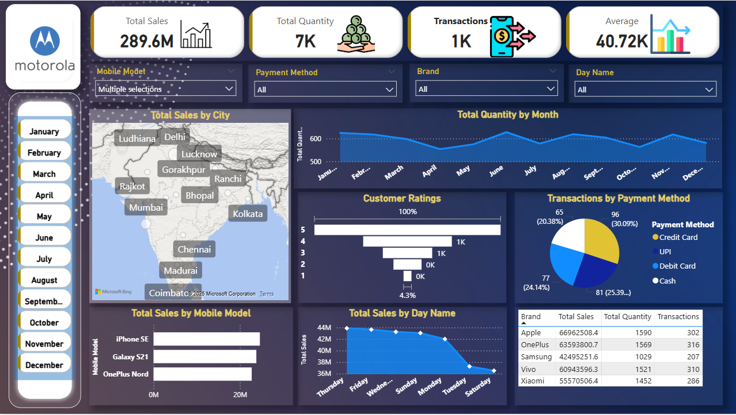

Power BI Dashboard Overview
Visual representation of sales analysis using Power BI.

Slide 9
Conclusion and Recommendations
Data-driven insights help improve sales strategy
Focus on high-performing models and cities
Optimize payment options based on transaction trends
Enhance customer experience for better ratings

Slide 10
Thank You !

